Slide 1

INTRODUCTION TO CONCEPTUAL DATA MODELING

Slide 2
Objective
Introduction
Database Design Process
Requirements
Conceptual Design
Entity-Relationship Model
CS204 Database System

Slide 3
Introduction
A database application refers to a particular database and the associated programs that implement the database queries and update.
  Example: A bank database application consists of the customer data of the bank in addition to the programs that will implement all the customer transactions such as deposit and withdrawal.
Designing a Database application involves designing
  The database
  And the associated programs.
CS204 Database System

Slide 4
Database Design Process
The first two steps in designing a database are:
  Collecting and analyzing requirements
  Conceptual Design
CS204 Database System

Slide 5
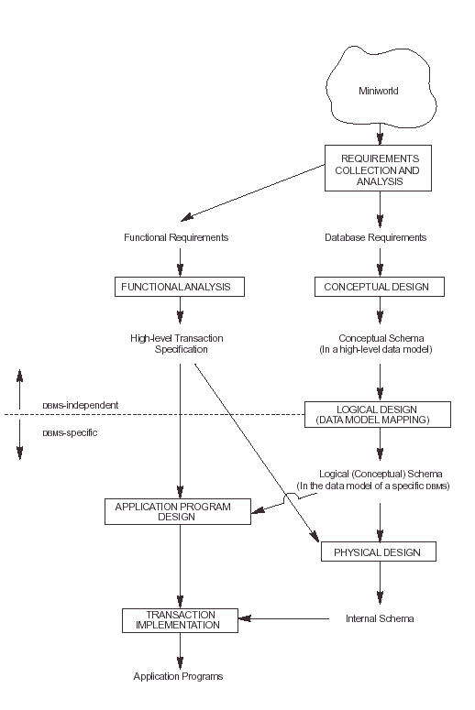
Database Design Process
CS204 Database System

Slide 6
Requirements
The first step in designing a database is collecting, documenting, and analyzing requirements.
In the next few slides we will show requirements of:
  A Company Database (Enterprise)
  A University Database (Enterprise)
CS204 Database System

Slide 7
Company Database Requirements …
The company is organized into departments.
Each department:
  Has a unique number
  Has a unique name
  Has a manager
  May have several locations
A department controls a number of projects.
Each project:
  Has a unique number
  Has a unique name
  Has one location
The company stores each employee’s:
  Social security number
  Name
  Address
  Salary
  Sex
  Date of birth
CS204 Database System

Slide 8
Company Database Requirements …
The company:
  Assigns an employee to one department but may work on several projects, which are not necessarily controlled by the same department
  keeps track of the number of hours per week that an employee works on each project.
  Keeps track of the direct supervisor of each employee
  Keeps track on the dependants of each employee for insurance purposes. It keeps each dependants:
    Name
    Sex
    Birth date
    Relationship to employee
CS204 Database System

Slide 9
University Database Requirements …
The university keeps track of each student
  Unique number
  Unique social security number
  Name
  current address
  Current phone
  Permanent address
    City
    State
    Zip code
  Permanent phone
  Birth date
  Sex
  Class (freshman, sophomore, …)
  Department
  Degree program (BA, BS, …, PhD)
The university also keeps track of each department
  Name (unique)
  Department code (unique)
  Office number
  Office phone
  college
CS204 Database System

Slide 10
University Database Requirements …
Each course has:
  Name
  Description
  Number (unique)
  Number of semester hours
  Level
  Offering department
Each section has:
  Number (unique per semester per course)
  Semester
  Year
  Course
  An instructor
Each grade report has:
  student number
  section number
  letter grade
  Numeric grade (0, 1, 3, or 4)
CS204 Database System

Slide 11
Entities of Company & University Databases
Entities of:
  Company database
    Employees
    Departments
    Projects
    Dependents
  University Database
    Students
    Departments
    Courses
    Sections
    Grade reports
CS204 Database System

Slide 12
Conceptual Design
Conceptual modeling +
Entity-Relationship model +
CS204 Database System

Slide 13
Conceptual Modeling
Once the requirements have being collected and analyzed, the next step is to create a conceptual schema for the database.
A Conceptual schema is a concise description of the data requirements of the user and it contains:
  Detailed description of the entity types
  Relationships
  constraints
Conceptual schema is created using a high level conceptual data model
Here, we will present the Entity-Relationship model, which is a popular high-level conceptual model, and we will use it in designing a database application.
CS204 Database System

Slide 14
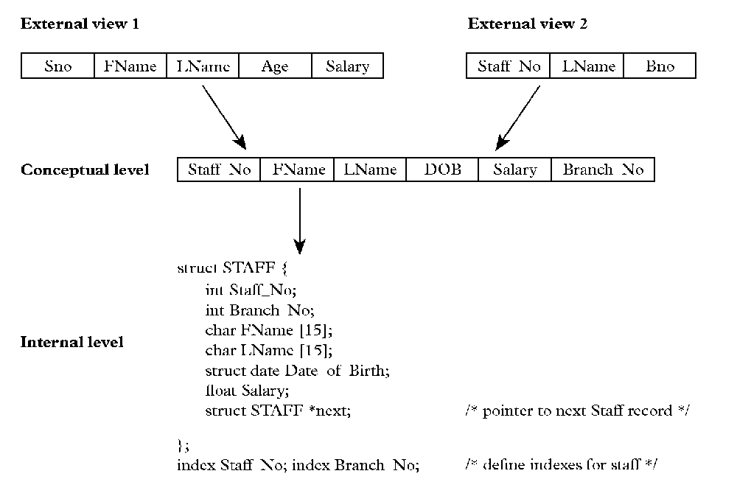
Example of The Three-schema Architecture
11
CS204 Database System

Slide 15
Entity Relationship Model
Definition +
Entities +
Attributes +
CS204 Database System

Slide 16
Definition
The Entity-Relationship (ER) model is a high-level conceptual data model that is widely used in the design of a database application.
The ER model represents data in terms of:
  Entities
  Attributes of entities
  Relationships between entities
Underlined attributes are Key Identifiers,
Those can be unique or PK during Implementation
CS204 Database System
Notes:
There is no PK and FK are used in ER Modeling

Slide 17
A Motivating, Running Example
Section 2 > Data models
Consider building a course management system (CMS):
  Students
  Courses
  Professors
  Who takes what?
  Who teaches what?
  What about Sales Items System?
  Car Point of Sale and Services System?
Entities
Relationships
Notes:
Customer, Ordering, Items
Car, Maintenance, Servicing Cars, Employees
Relationship: Constraints in DB Implementations, Entity will be a table DB Implementations
Semester is missing?

Slide 18
Entities (Purpose of Storing Data)
An entity is an object or a concept that is identified by the enterprise as having an independent existence.
There are two types of entities:
  Physical entities
    Example: car, house, employee, part, supplier, building
  Conceptual entities
    Example: job, university course, sale, work experience, CourseReg
Entity
1-Has its own data in the form of table
2-Contains at least two valid attributes
3-Contains at least one key identifier
4-Does not have its derived data (Transcript is not an entity)
CS204 Database System
Notes:
Meaning and concepts of COURSE are different in College and University Enterprises, ITEM is treated differently in Purchasing Co. and Manufacturing Co.

Slide 19

Entity …
An Entity is something about which we store data for use by managers and workers of an Enterprise. An entity can be either an item found in reality or an abstract concept.
  Person: EMPLOYEE, STUDENT, PATIENT
  Place: CITY, DEPARTMENT
  Object: MACHINE, BUILDING, AUTOMOBILE
  Event: CUSTOMER_ORDER, INVENTORY_RENEWAL
  Concept: ACCOUNT, COURSE, WORK_CENTER
  Social Media: Blogs, Pics, Audio/Videos
CS204 Database System

Slide 20
Attributes
Definition +
Types of attributes +
CS204 Database System

Slide 21
Definition – Attributes (Properties)
An attribute is a property that describes an entity.
Example:
  The attributes of the entity CAR are:
    Make
    Chassis number
    Color
  The attributes of the entity EMPLOYEE are:
    Name
    Date of birth
    Address
There are many types of attributes.
CS204 Database System

Slide 22
Types of Attributes
Simple Vs Composite Attributes +
Single-valued Vs Multi-valued Attributes +
Derived Vs Stored Attributes +
Complex attributes +
CS204 Database System

Slide 23
Simple Vs Composite Attributes
A simple attribute:
  Consists of a single component with an independent existence.
    Example: The Sex attribute of an EMPLOYEE entity
A composite attribute:
  Consists of multiple components each with an independent existence.
    Example: The Address attribute of an EMPLOYEE entity can be divided into Street, City, State, Zip.
Address
Street
City
State
Zip
CS204 Database System
Notes:
Other examples of Composite Attributes
FullName: Fname, Mname, Lname
Contacts: Mobile, LandPhone, Email, Fax, URL
Just Date is not composite because it is trivial, it has DD, MM and YYYY parts with time, even date format is not composite

Slide 24
Single-valued Vs Multi-valued Attributes
Single-valued attribute:
  Holds a single value for a single entity.
    Example: the Sex attribute of an EMPLOYEE entity. Blood group like A, B, A+, O+ etc.
Multi-valued attribute:
  An attribute that holds more than one value for a single entity.
    Example: The Color attribute of a CAR entity, more than college degrees taken by students
    Example: Multiple Phone numbers
CS204 Database System
Notes:
Simple and Single valued attributes are mostly same. We can claim Simple are very fewer from 0 to 9 and Single attributes are fewer 0 to 99 or less

Slide 25
Derived Vs Stored Attributes
Derived attribute:
  Is an attribute that represents a value that is derived from the value of a related attribute or set of attributes not necessarily in the same entity.
    Example 1: The value of the Age attribute of the EMPLOYEE entity can be derived from the today’s date and the value of the employee BirthDate.
    Example 2: The NumberofEmployees attribute of a DEPARTMENT entity can be derived from the EMPLOYEE table by counting the number of employees who work in that department.
Stored attribute:
  Is an attribute that is not derived but which is directly stored in the entity.
    Example: The Sex attribute in the EMPLOEE entity, if age is stored in database then age can be a stored attribute.
CS204 Database System

Slide 26
Complex attribute
Is an attribute that is a nested combination of composite and multi-valued attributes in an arbitrary way.
  Example: The complex attribute AddressPhone.
  {AdressPhone({Phone(AreaCode, PhoneNumber)},
  Address(StreetAddress(Number, Name, HouseNumber),
  City, State, Zip))}
  Note:
    Comma is used for separating the components
    {} Represents multi-valued attributes
    () is used for arbitrary nesting and grouping
CS204 Database System
Notes:
Another example, Address→Perm Address, Mailing Address

Slide 27
Exercise: Give Attributes of the following Entities
Course
Semester
Dependent
Parts
Invoice
Product/ Items
Skills
Book
Project
PatientVisit
Loan
LoanInstallments
Bank-Branch
Passport
Building
CourseOffered
CourseRegistration
etc.
CS204 Database System
Notes:
Putting right column in right entity.

Slide 28
END
CS204 Database System

